Slide 1

Inno Lab
内衣清洗机
汇报人：夏凡
指导老师：陈雪
小组成员：夏凡，周敏，龙介峰

Slide 2

Part 1
课题背景
Feedback and summary

Slide 3

01
intro
01
01
大学生住宿，宿舍衣物清洗
中国烘衣市场的不足
洗衣痛点
公用洗衣机卫生问题
洗鞋机不实用……

Slide 4
如何让大学生能够既方便
又卫生的清洗内衣
What’s our problem?

Slide 5
01
Why is it important？
01
01
尿道炎，前列腺
59%
女性为宫颈炎受害者
42%
各种阴道炎正在威胁着
的女性
皮肤湿疹，过敏
3
每
女性身上，便有一位是曾患有子宫肌瘤

Slide 6
Part 2.1
中国整体家电市场
Overall analysis of home appliance market in China

Slide 7
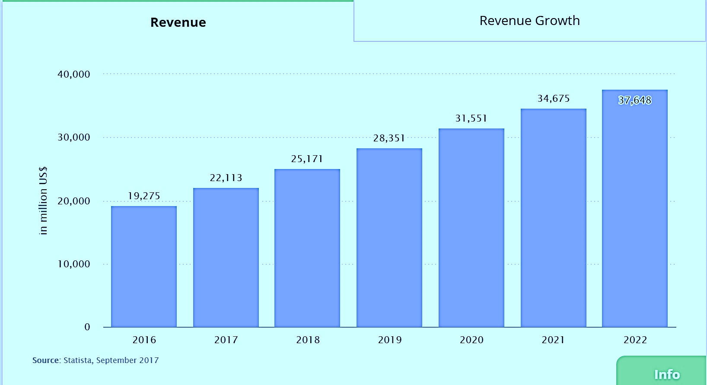
01
中国家电市场收益大，但呈增长率下降趋势
01
01
Home appliance market revenue is big, but shows downtrend.

Slide 8
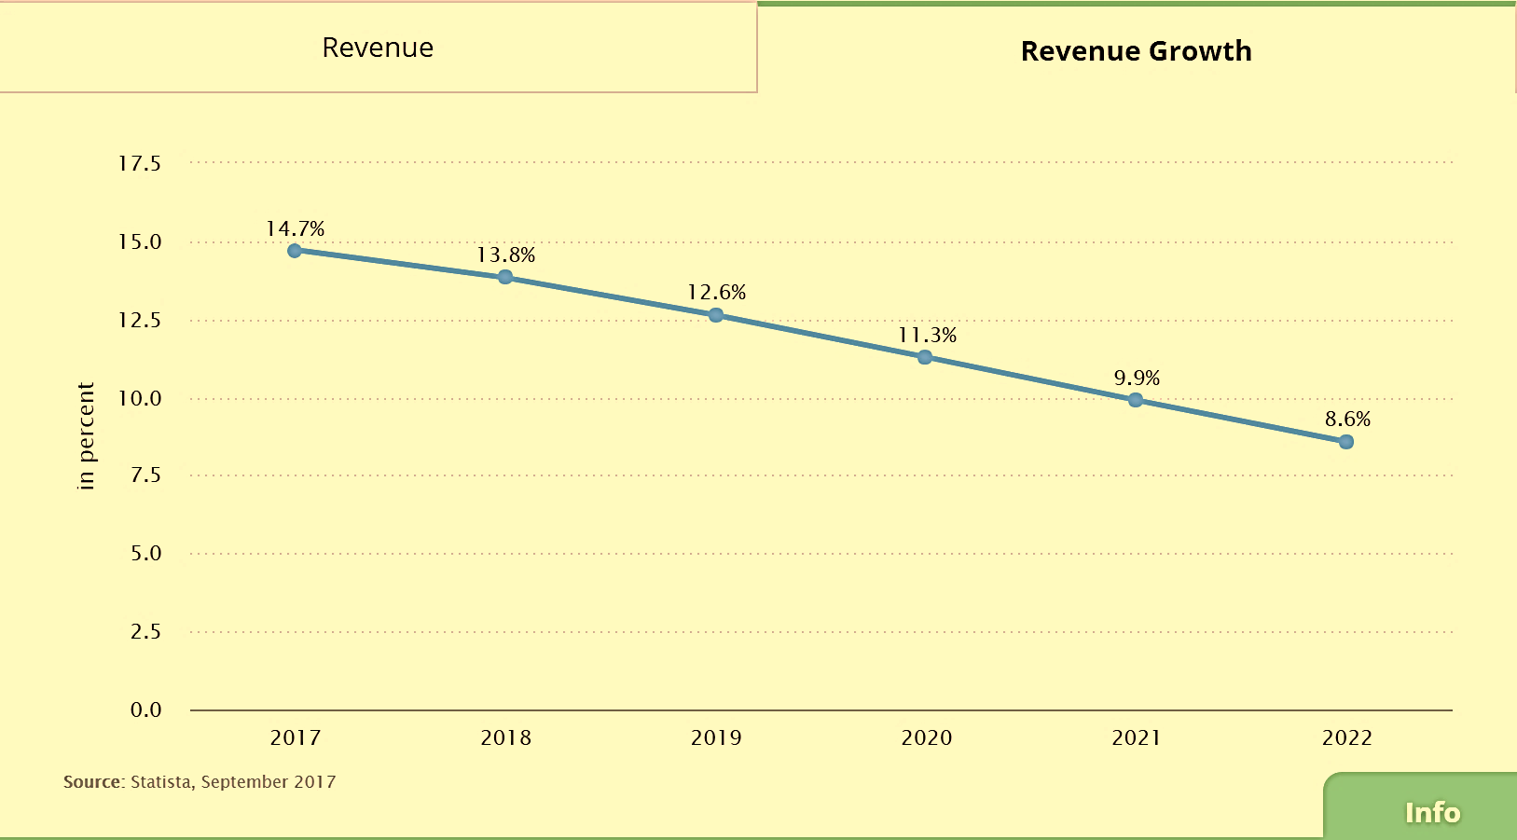
01
中国家电市场收益大，但呈增长率下降趋势
01
01
Home appliance market revenue is big, but shows downtrend.

Slide 9
Part 2.2
洗衣机市场
Analysis of washing machine market

Slide 10
01
洗衣机市场总体平稳
01
The market for washing machines is generally stable
洗衣机行业
海尔的洗衣机
2017年1~6月
零售量1789万台，同比增长8.2%
零售额同比增长10.3%
累计产量增长3.55%
Source：中国家用电器协会洗衣机专业委员会
2017年1~6月
零售额份额提升2.04个百分点，份额提升值居于行业第一
Source：海尔的2017半年度报告

Slide 11

02
普通家用洗衣机种类丰富、功能齐全
Ordinary household washing machines are rich in variety and function.
基本覆盖所有消费人群
消毒方式多样
低端、中端、高端都有较多产品
产品尺寸符合家庭空间
高温、臭氧、蒸汽、紫外线、蓝光等
一应俱全、满足不同需求
品牌众多
多种操作方式
国内：海尔、小天鹅、美的等
国外：西门子、惠而浦等
按键、旋钮、触屏
各大品牌都有涉及
功能齐全
智能、节能
洗烘一体、杀菌消毒、防皱
西服、羽绒服都可清洗
减震、静音
多采用全自动技术
变频电机高效节能
Source：国美、苏宁&淘宝京东

Slide 12
02
Washing machine market trends
Ordinary household washing machines are rich in variety and function.
Traditional Laundry Market
Meet more detailed user needs
The ultimate user experience

Slide 13
Personalized Products
Healthier
Focus on user health
Focus on powerful cleaning
Smaller
Classification
Refine laundry types

Slide 14
03
内衣清洗机
Underwear cleaning machine
Source：淘宝、京东等

Slide 15
Part 3
用户调查
User research

Slide 16
01
大学生消费能力强
College students have strong consumption ability.
Source：事实说调查，腾讯问卷

Slide 17
02
用户数量估计
The number of users is estimated.

Slide 18
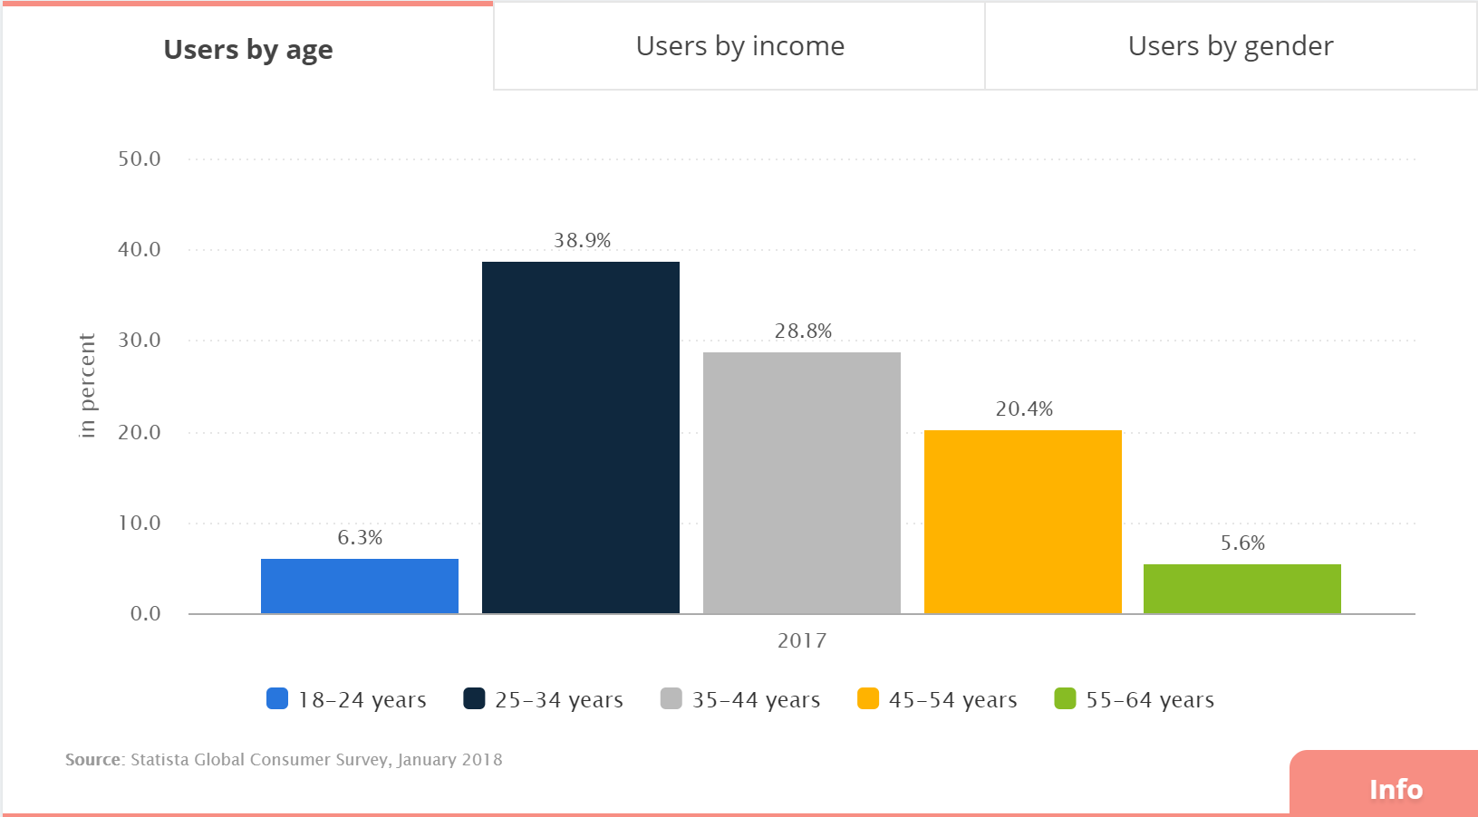
03
大学生市场空缺
University student market vacancy
Notes:
因为空缺 所以需要抢占

Slide 19
04
大学生消费心理与习惯
College students' consumption psychology and habit
Source：中国知网

Slide 20
05
用户对于清洗内衣方面的想法
Users' thoughts on washing underwear.
特征 | 效用（*10^-2） | 特征 | 效用（*10^-2）
无特殊处理 | -120 | 1Y | -4
无异物 | -59 | 3Y | 0
无细菌 | 0 | 10Y | -5
￥200 | 23 | 一个电饭煲大小 | 68
￥400 | 0 | 半个单门冰箱 | -2
￥1000 | -3 | 正常洗衣机 | 0
混洗 | -47 | 分开清洗 | 0
用户更关心清洁程度与尺寸

Slide 21
05
Users' thoughts on washing underwear.
Users' thoughts on washing underwear.
40% of users want to change the way they clean and free their hands

Slide 22
05
Users' thoughts on washing underwear.
Users' thoughts on washing underwear.
Users generally wash underwear less frequently
which is not conducive to personal health

Slide 23
06
用户生活方式引导
Users‘ lifestyle guidance.
每日清洗内衣内裤的生活概念
对于贴身内衣清洗的重视程度缺失
对内衣内裤清洗的不卫生及相关常识的缺失
市场空缺较大

Slide 24
Part 4.1
产品设计
Product design

Slide 25
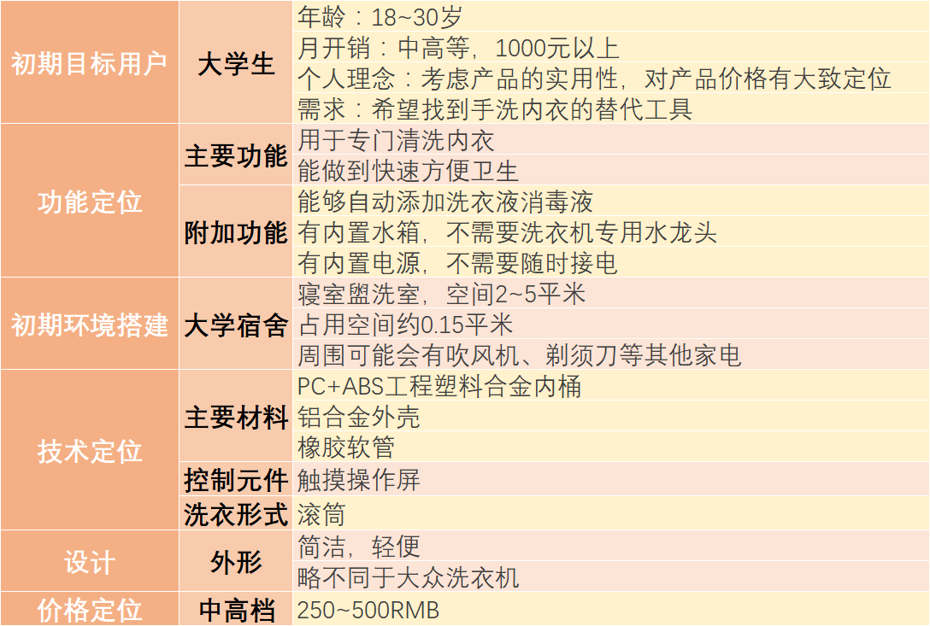
PRE
设计定位
Design Orientation

Slide 26





01
切中用户痛点，填补市场空缺
Cut the user pain point and fill the market vacancy.
创新是时代的潮流
市场上缺少宿舍用内衣清洗机
用户群体庞大
用户需要内衣清洗机来帮助他们
用户希望洗衣机更小巧、更干净
每日清洁内衣内裤的观念

Slide 27
02
产品特点
The feature of our product
清洗速度快
The cleaning speed is really too fast.
It can't be any faster.
价格合理
占地空间小
The price is really reasonable.
No more reasonable.
The space is really too small.
It can't be any smaller.
操作简单
卫生
The operation is really too simple.
It can't be simpler.
It's too sanitary.
No more sanitation.
省事
It's really saving time.
It can't save any more.

Slide 28
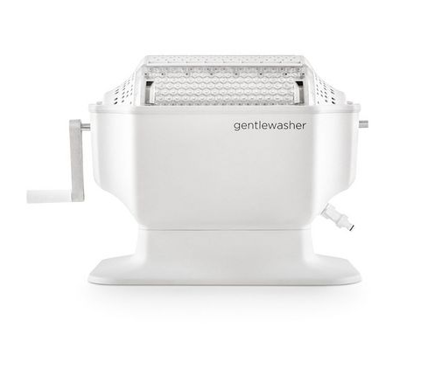
03
产品灵感来源
Product inspiration
原型：Gentlewasher手摇洗衣机【荷兰初创品牌Monono 】
适用面料：内衣，羊绒、丝绸面料的衣服，健身服装，婴儿服装
洗衣时间：5min
容量：19升

Slide 29
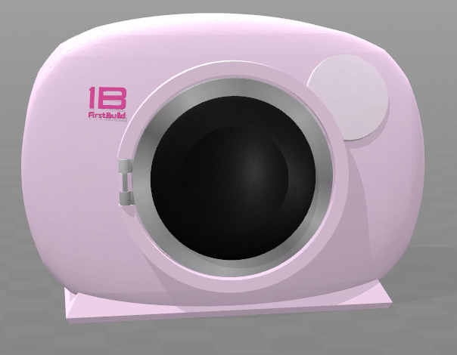
06
Product Model
Product model
SIZE：300mm*300mm*500mm
Front exterior view

Slide 30
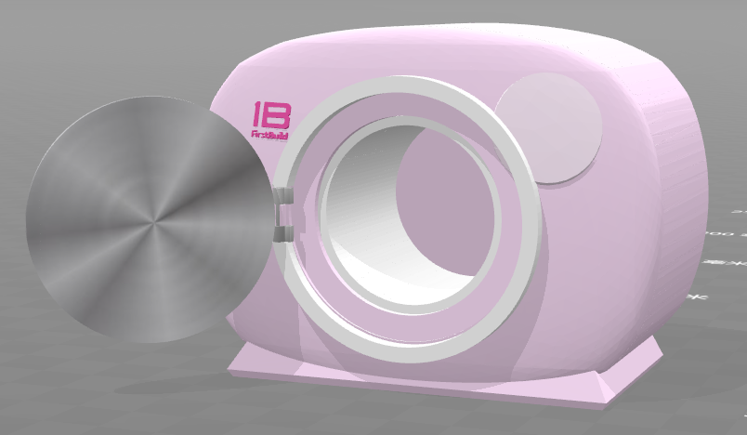
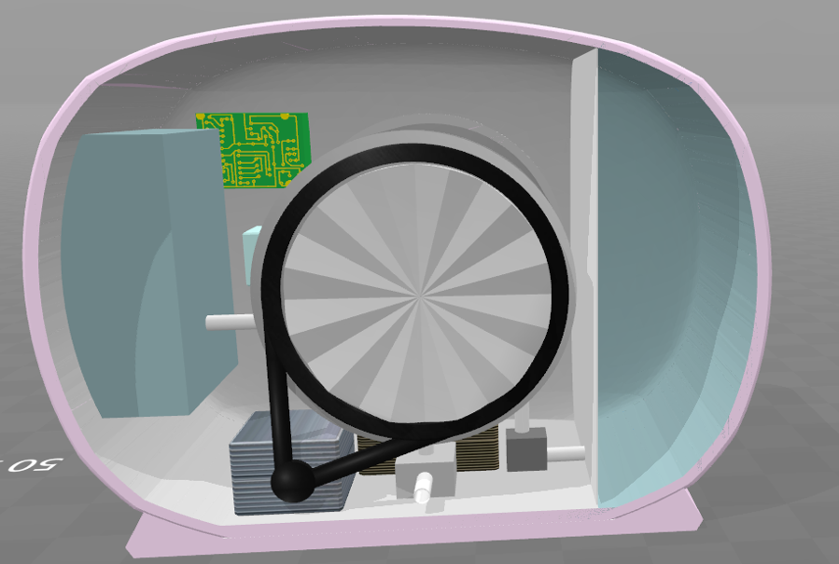
06
Product Model
Product model
Water tank
Controller
Storage of laundry detergent& disinfectant
Front exterior view
Back-section view

Slide 31
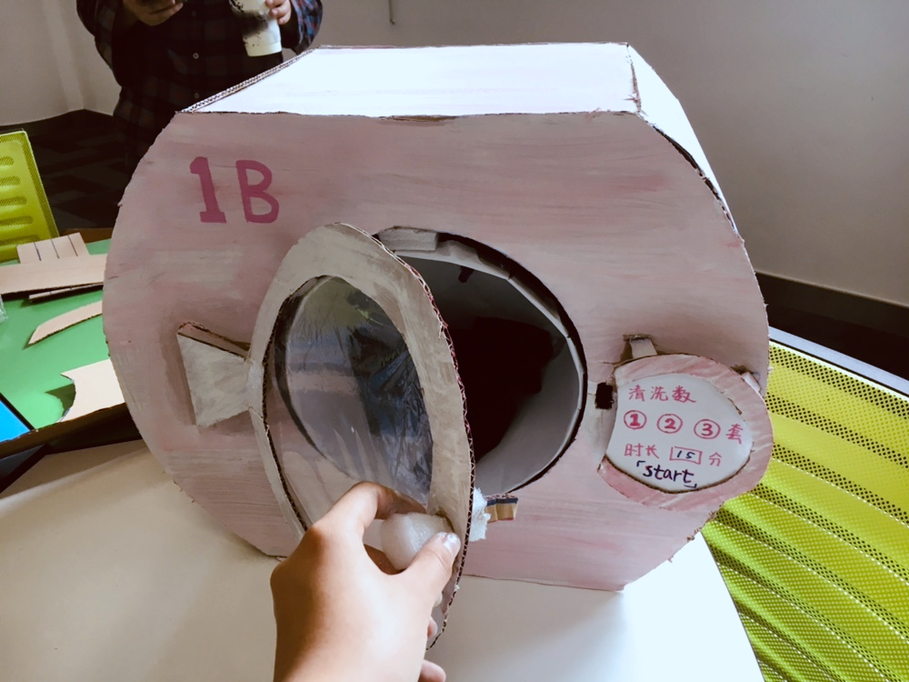
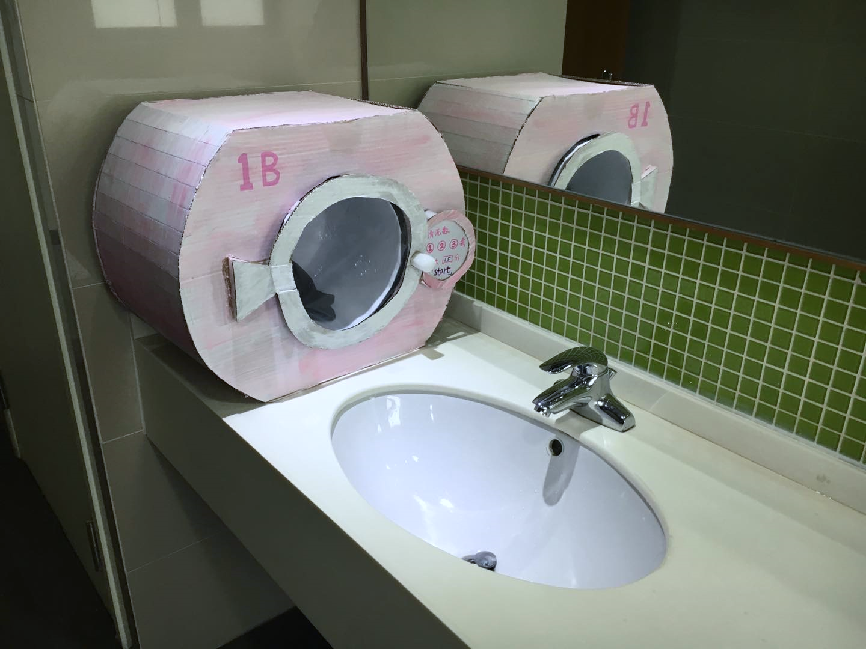
04
产品模型
Product model

Slide 32
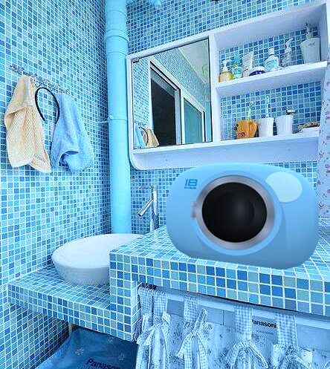
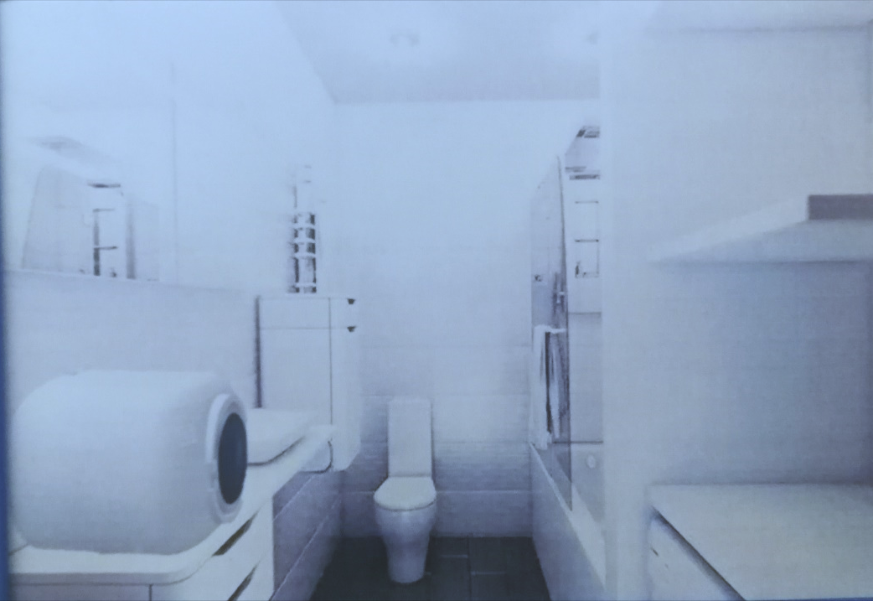
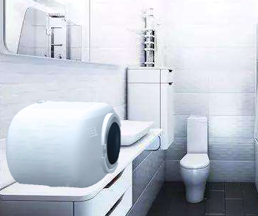

Slide 33
Part 4.2
成本分析
cost analysis

Slide 34
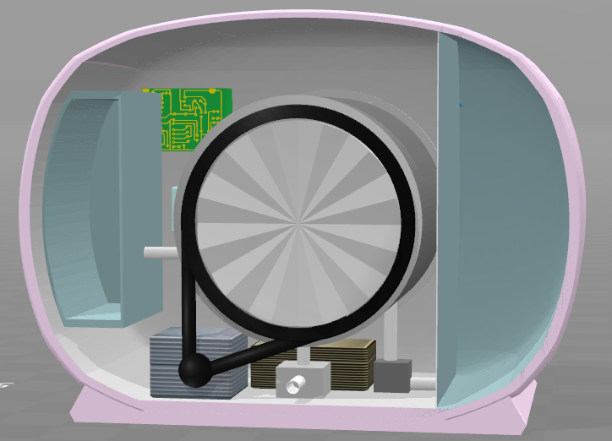
04
内部图
print the presentation and make it into a film to be used in a wider field
电路版
水位传感器
水箱
清洁剂箱
电池
电机
进水阀
排水阀

Slide 35
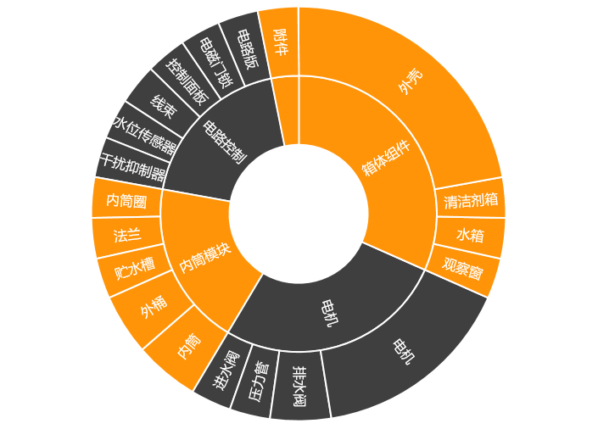
01
成本分析
cost analysis
箱体组件
外壳…………50
观察窗………5
水箱…………5
清洁剂箱……5
65.00￥
电机
电机…………30
排水阀………10
进水阀………5
压力管………<1
46.00￥
内筒模块
内筒…………12
外桶…………10
内筒圈………<1
法兰…………5
贮水槽………5
33.00￥
附件
包装箱………1
泡沫角垫……1
说明书………1
线扎…………<1
电线…………<1
5.00￥
电路控制
电路版………10
电磁门锁……10
控制面板……1
线束…………<1
水位传感器…5
干扰抑制器…7
34.00￥
合计：183.00￥

Slide 36
02
成本构成分析——据洗衣机成本年度研究报告数据
Cost composition analysis -- according to the annual study report of washing machine cost.

Slide 37

02
成本构成分析——据洗衣机成本年度研究报告数据
Cost composition analysis -- according to the annual study report of washing machine cost.
Notes:
管理成本：薪酬，研究开发，税费，租赁。。。。

Slide 38
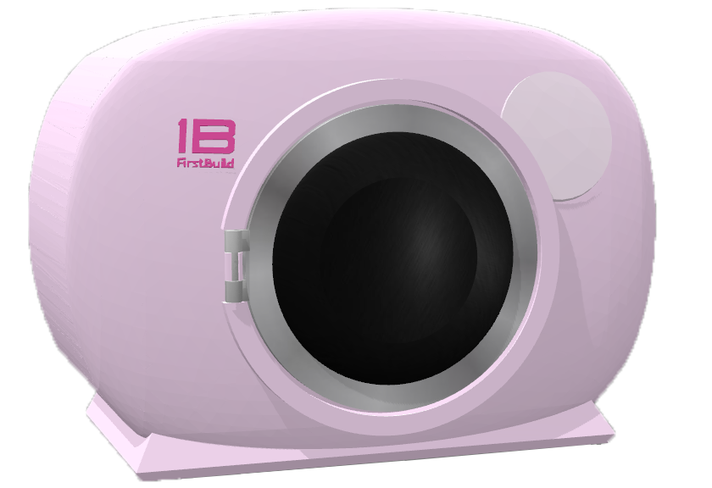
03
成本分析
cost analysis
=183÷0.75÷0.7≈348￥
每台原料+生产+销售→成本

Slide 39
Part 5
财务分析
Finanical analysis

Slide 40
01
用户数量
The number of users
收入在1000元以上的大学生：1860.1万
认为清洗内衣内裤等贴身衣物麻烦的大学生：49.53%
用户总数量：921.3万

Slide 41
02
第一年的销售策略
First year‘s sales strategy
发起京东众筹
只做线上销售
依托微信、淘宝等平台
得到更多的用户反馈，进一步迭代产品
大学生很少去国美、永乐等线下家电卖场
社交网络及淘宝、京东的普及
减少不必要的宣传费用及销售成本

Slide 42
03
The number of users in the first year is estimated
The number of users in the first year is estimated
Worst: 1,000 units per month on average, 0.13% of the total number of users
Best: 23,756 units per month, or 3.1% of the total number of users
Most likely: 8091 units per month on average, accounting for 1.05% of the total number of users
Notes:
1000 淘宝比较差的产品 100/0.1（线下卖更多，其他平台，京东等）
23756 一款类似产品 众筹1个月的支持者
8091 淘宝上市五年左右的销量最好的

Slide 43
04
Financial analysis in first year
Financial analysis in first year
price | ￥350 each
 | best(万/年） | worst（万/年） | most likely（万/年）
revenues | 2608.62 | 1612.38 | 2006.76
COGS | 2061.33 | 1274.1 | 1585.74
Gross margin | 547.29 | 338.28 | 421.02
Gross margin% | 20.98% | 20.98% | 20.98%
marketing | 62.07 | 61.93 | 61.99
tax | 72.783 | 41.4525 | 53.8545
net income | 412.437 | 234.8975 | 305.1755
net income% | 15.81% | 14.57% | 15.21%

Slide 44
05
后续销售策略
next years’ sales strategy
众筹
淘宝、京东等在线销售平台
微信、微博等社交软件推广
增加在线销售平台如：苏宁、国美
线下同步销售，进驻国美、永乐等
线下销售点同步推广

Slide 45
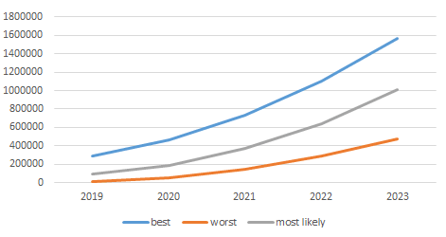
06
The number of users in the first five years is estimated
The number of users in the first five years is estimated
≈17%
≈11%
≈5%
Notes:
假设：大学生人数每年增加3%
逐年增长量递增
D = 第一年按照总人数的比例得出

Slide 46
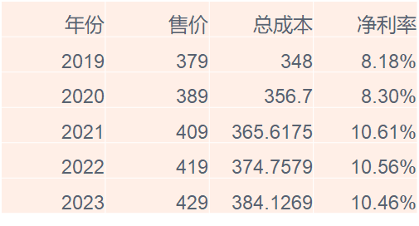
06
五年的净利润估计
A five-year net profit estimate

Slide 47
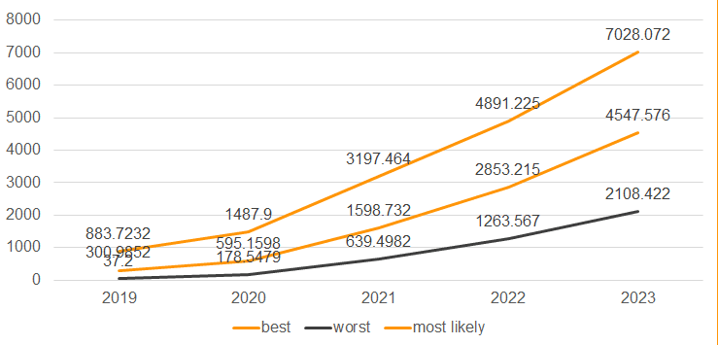
06
A five-year net profit estimate
A five-year net profit estimate

Slide 48
08
Monte carlo analysis
Monte carlo analysis
Most likely：356,464 yuan
（first year）

Slide 49
Part 6
Version2.0
Finanical analysis

Slide 50
06
用户反馈
Users‘ feedback
suggestions
1.封闭水箱储水的清洁性，是否会长绿藻等
2.电源问题（可能部分学校盥洗室没有插头）
3.希望轻洗得更干净（尤其女性特殊时期）
4.还是有点大

Slide 51
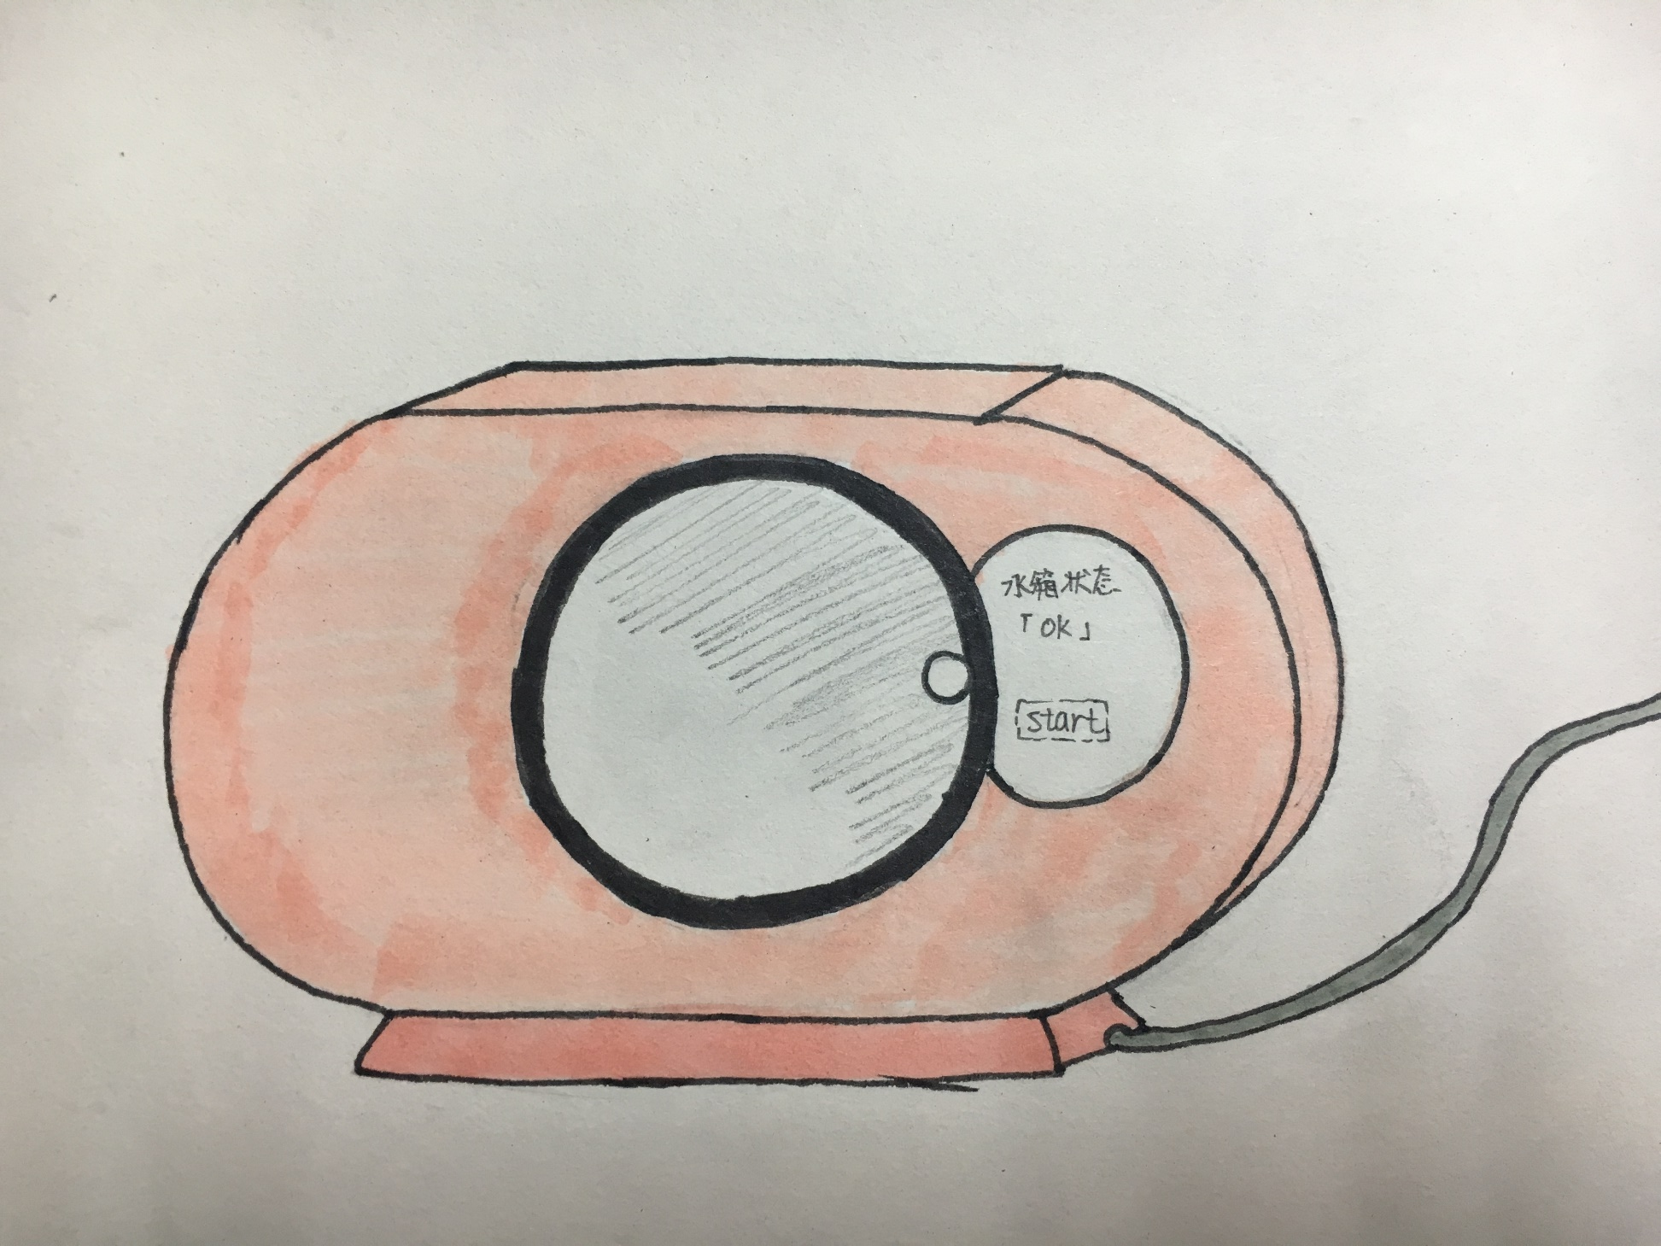
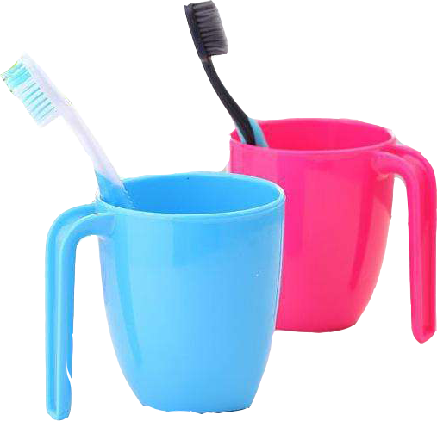
07
第二代产品
Version 2.0

Slide 52
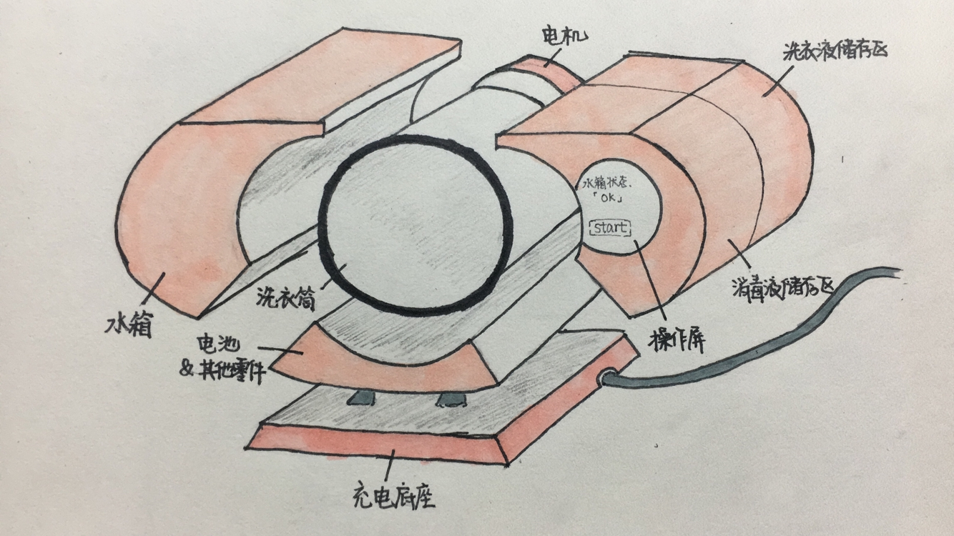
07
第二代产品
Version 2.0

Slide 53
07
第二代产品
Version 2.0
充电底座
再使用时无需插电，不受地点约束
再也不用担心盥洗室没有插头
02
可拆卸式水箱
体积缩小1/3
方便观察及清洗
解决了封闭水箱的清洁问题
01
03
将每日清洗坚持到底！
04
高温煮洗
顽固污渍也能轻松去除
提高清洁度

Slide 54
Thank you for watching

Slide 55
01
Washing machine market trends
Ordinary household washing machines are rich in variety and function.
Traditional Laundry Market
Meet more detailed user needs
The ultimate user experience

Slide 56
Personalized Products
Healthier
Focus on user health
Focus on powerful cleaning
Smaller
Classification
Refine laundry types

Slide 57
02
Users' thoughts on washing underwear.
Users' thoughts on washing underwear.
40% of users want to change the way they clean and free their hands

Slide 58
03
Users' thoughts on washing underwear.
Users' thoughts on washing underwear.
Users generally wash underwear less frequently
which is not conducive to personal health

Slide 59
04
Product Model
Product model
SIZE：300mm*300mm*500mm
Front exterior view

Slide 60
46
Product Model
Product model
Water tank
Controller
Storage of laundry detergent& disinfectant
Front exterior view
Back-section view

Slide 62
05
The number of users in the first year is estimated
The number of users in the first year is estimated
Worst: 1,000 units per month on average, 0.13% of the total number of users
Best: 23,756 units per month, or 3.1% of the total number of users
Most likely: 8091 units per month on average, accounting for 1.05% of the total number of users
Notes:
1000 淘宝比较差的产品 100/0.1（线下卖更多，其他平台，京东等）
23756 一款类似产品 众筹1个月的支持者
8091 淘宝上市五年左右的销量最好的

Slide 63
05
Financial analysis in first year
Financial analysis in first year
price | ￥350 each
 | best(万/年） | worst（万/年） | most likely（万/年）
revenues | 2608.62 | 1612.38 | 2006.76
COGS | 2061.33 | 1274.1 | 1585.74
Gross margin | 547.29 | 338.28 | 421.02
Gross margin% | 20.98% | 20.98% | 20.98%
marketing | 62.07 | 61.93 | 61.99
tax | 72.783 | 41.4525 | 53.8545
net income | 412.437 | 234.8975 | 305.1755
net income% | 15.81% | 14.57% | 15.21%

Slide 64
05
The number of users in the first five years is estimated
The number of users in the first five years is estimated
≈17%
≈11%
≈5%
Notes:
假设：大学生人数每年增加3%
逐年增长量递增
D = 第一年按照总人数的比例得出

Slide 65
05
A five-year net profit estimate
A five-year net profit estimate

Slide 66
05
Monte carlo analysis
Monte carlo analysis
Most likely：356,464 yuan
（first year）

